Slide 1
Climate Change
Effect of Climate Change

Slide 2
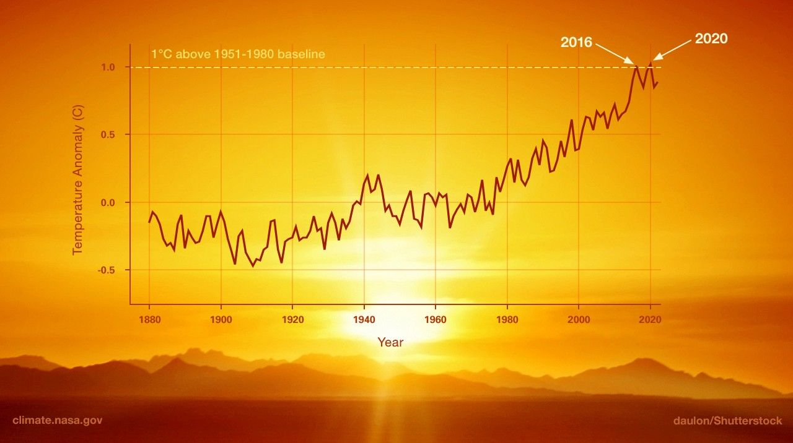
Effect of Climate Change
Harmful Effect
Potential Effect
01 | Rising Sea Levels
02 | Extreme Weather Events
03 | Loss of Biodiversity
04 | Heart Risk
01 | Longer Growing season in some regions
02 | Access to natural resources in Arctic Areas

Slide 3
What is Climate Change
Ans:Climate change is a long-term change in the average weather patterns that have come to define Earth’s local, regional and global climates. These changes have a broad range of observed effects that are synonymous with the term.

Slide 4
Climate Change Rate from 1950 to 2020

Slide 5
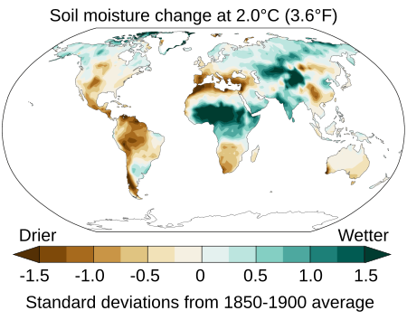
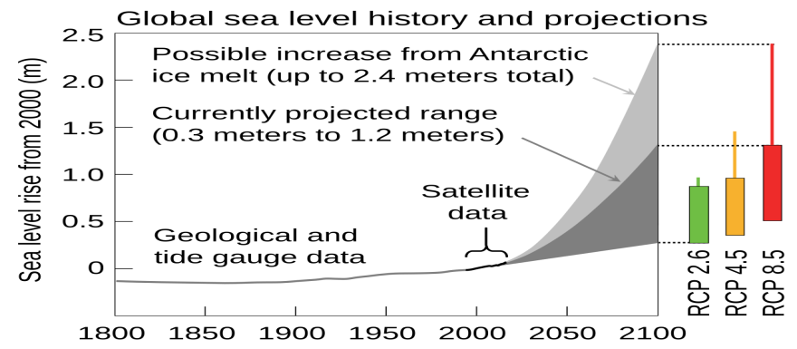
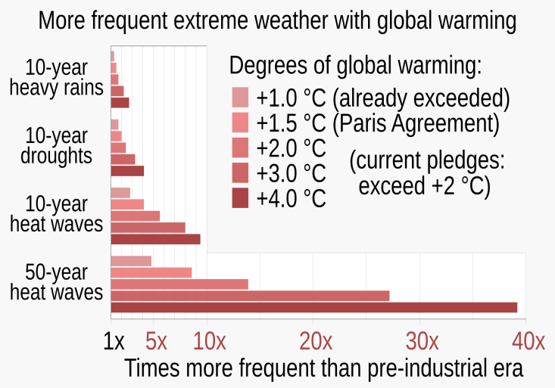
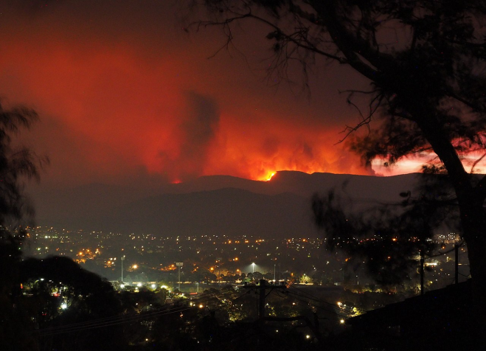
Environmental effects

